Slide 1
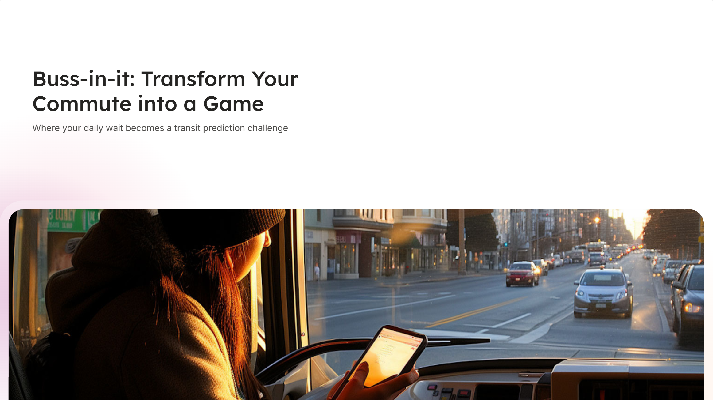
🚌 BUSS-IN-IT: The Ultimate Transit Prediction Game
Where your daily commute becomes your favorite game!

Slide 2
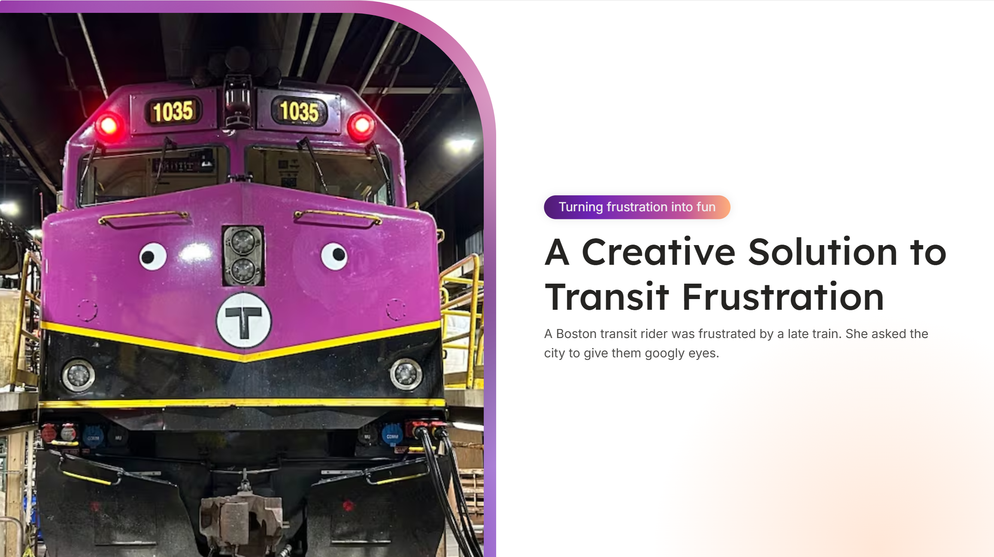
The Problem We're Solving
Ever stood at a bus stop wondering if your bus will actually show up on time? You're not alone!
Public transit delays are a daily frustration for millions of commuters worldwide.
We're turning this everyday challenge into an engaging and rewarding experience.

Slide 3
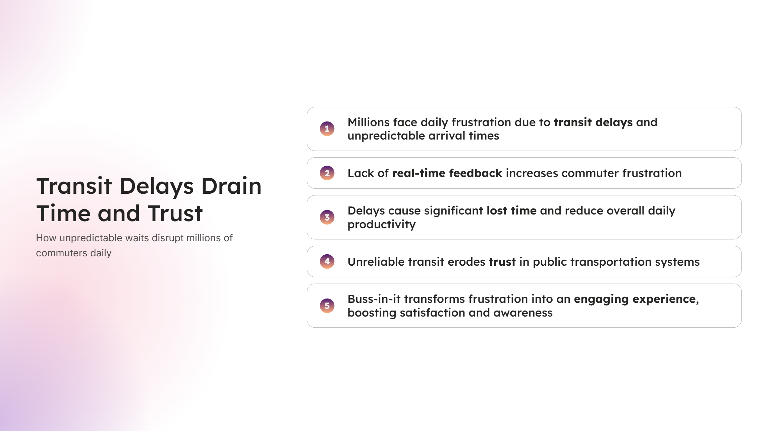
What is Buss-in-it?
A revolutionary web-based prediction game that transforms commute anxiety into an addictive, social gaming experience.
Using real-time Translink bus data, players predict whether buses will arrive on time or late.
Compete with friends, climb global leaderboards, and test your prediction skills.

Slide 4
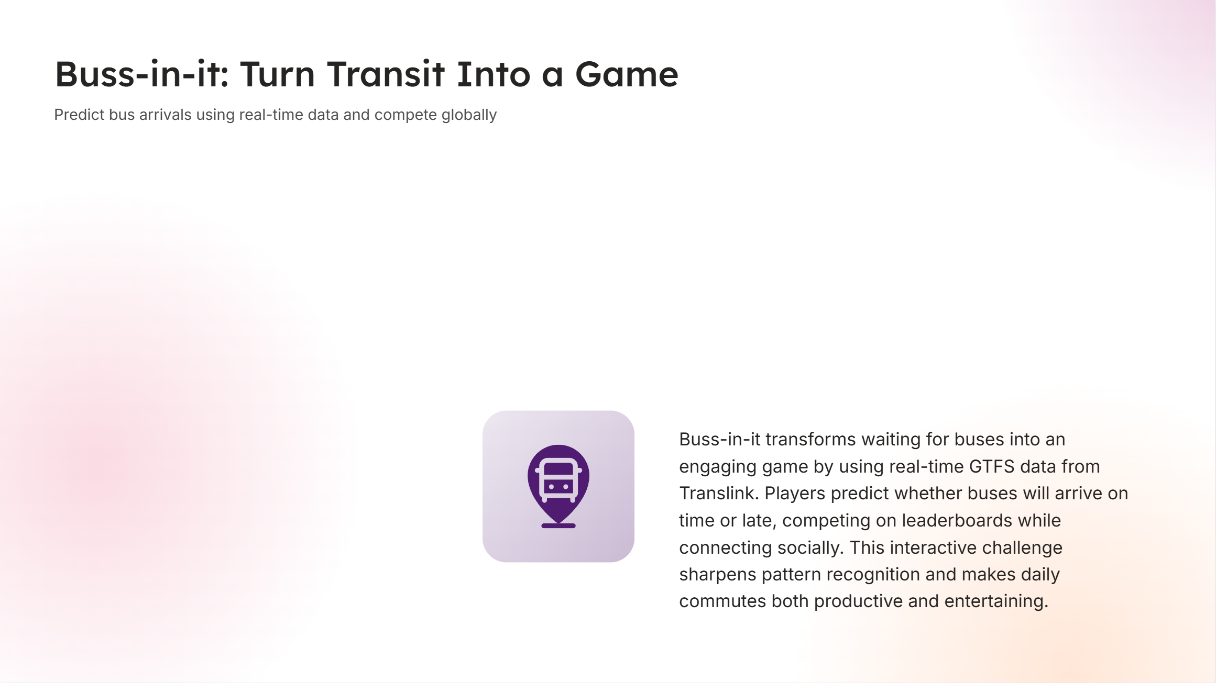
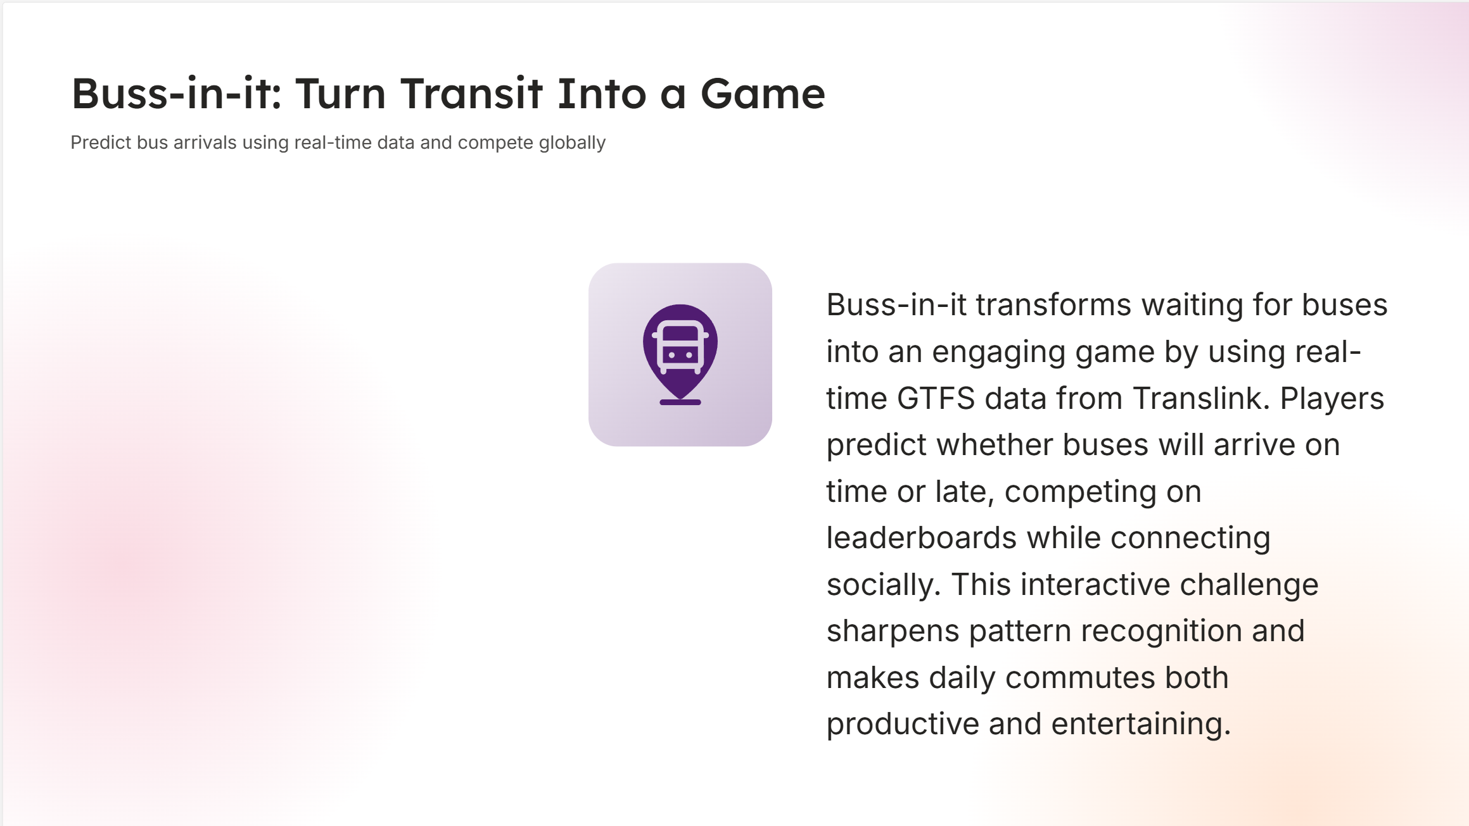

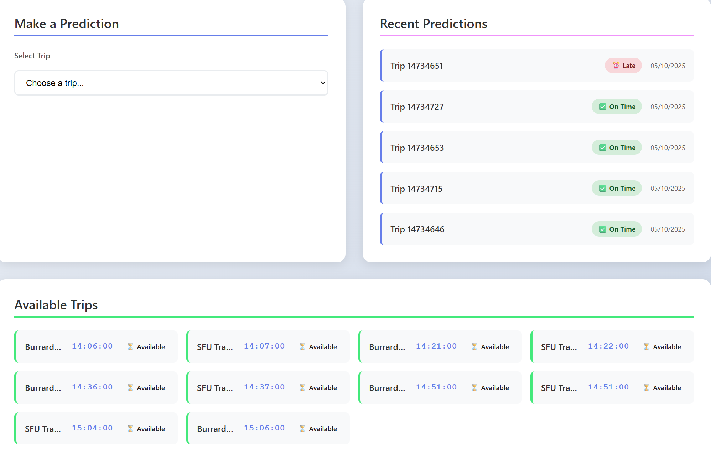
Why This is Genius
Real-World Impact: Turns transit frustration into entertainment.
Data-Driven: Uses actual GTFS real-time data for authentic predictions.
Social Gaming: Compete with friends and climb leaderboards.
Skill Development: Improves intuition and pattern recognition.
Community Building: Connects fellow commuters and enthusiasts.

Slide 5
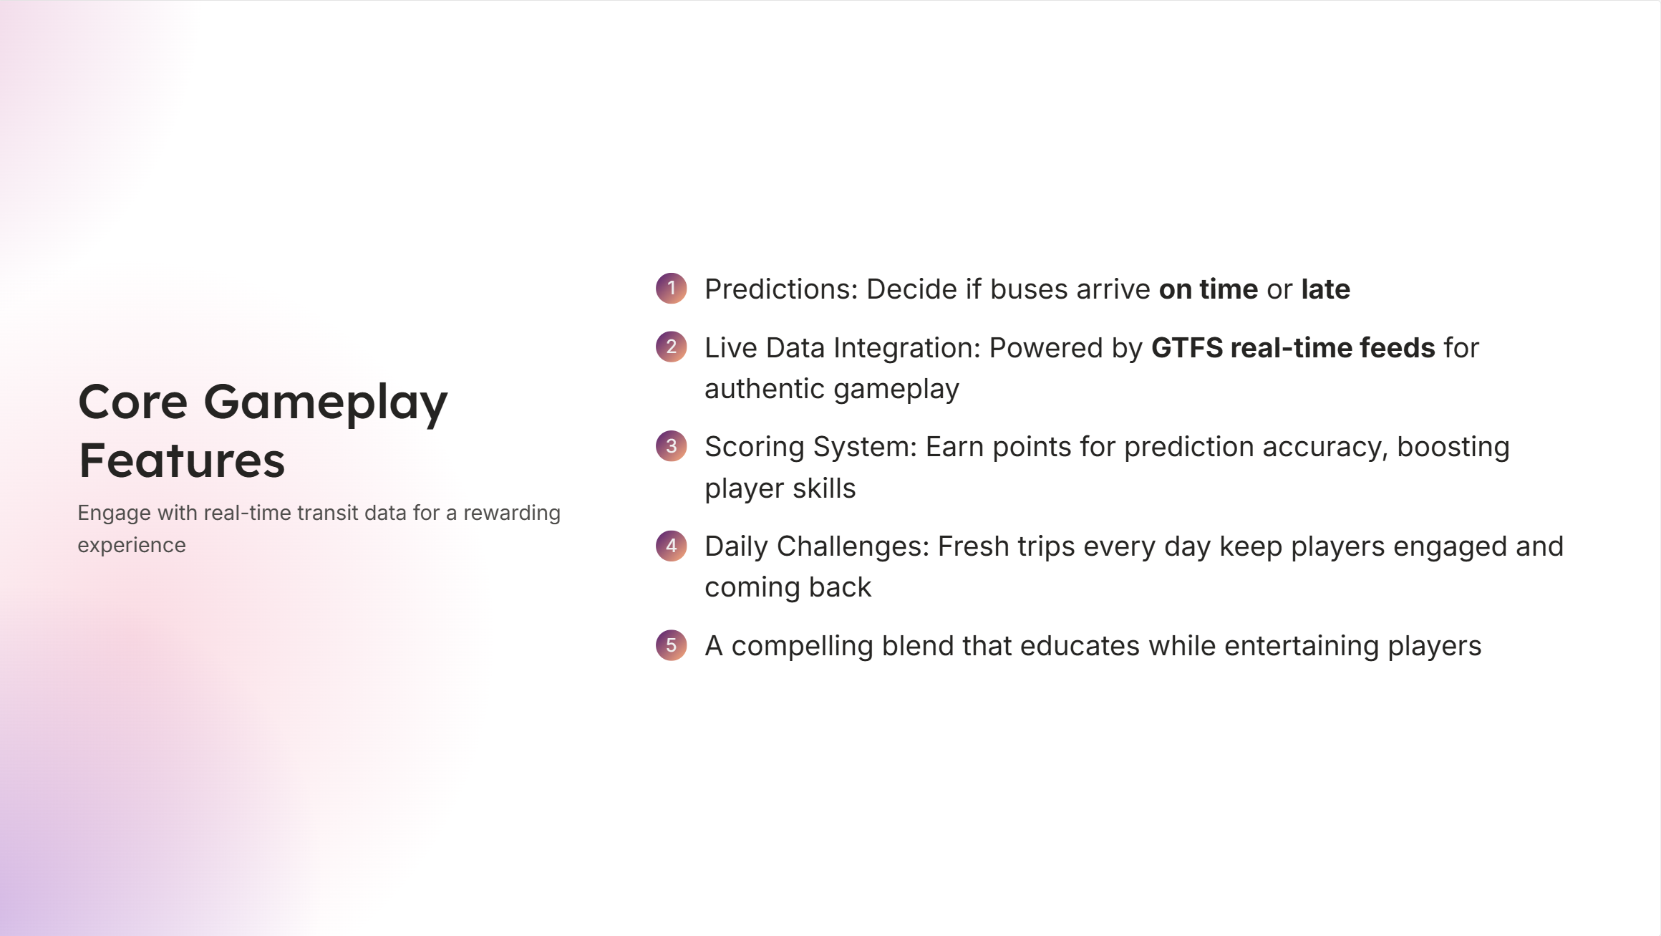
Core Gameplay Features
Smart Predictions: Predict if buses will be 'on time' or 'late'.
Live Data Integration: Real-time GTFS feeds for authentic, dynamic gameplay.
Scoring System: Earn points for accurate predictions.
Daily Challenges: Fresh trips every day keep the game exciting.

Slide 6
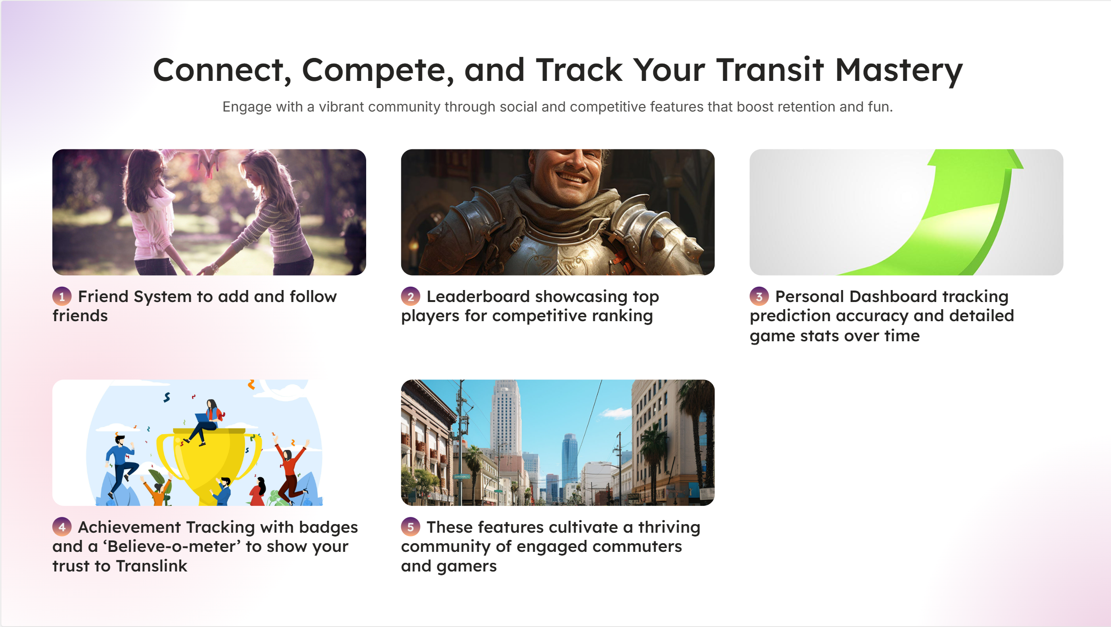


Social & Community
Friend System: Add friends and track each other's progress.
Global Leaderboard: Compete for the top spot against players worldwide.
Personal Dashboard: Track your stats and prediction history.
Achievement Tracking: Monitor your 'Believe-o-meter' accuracy.

Slide 7
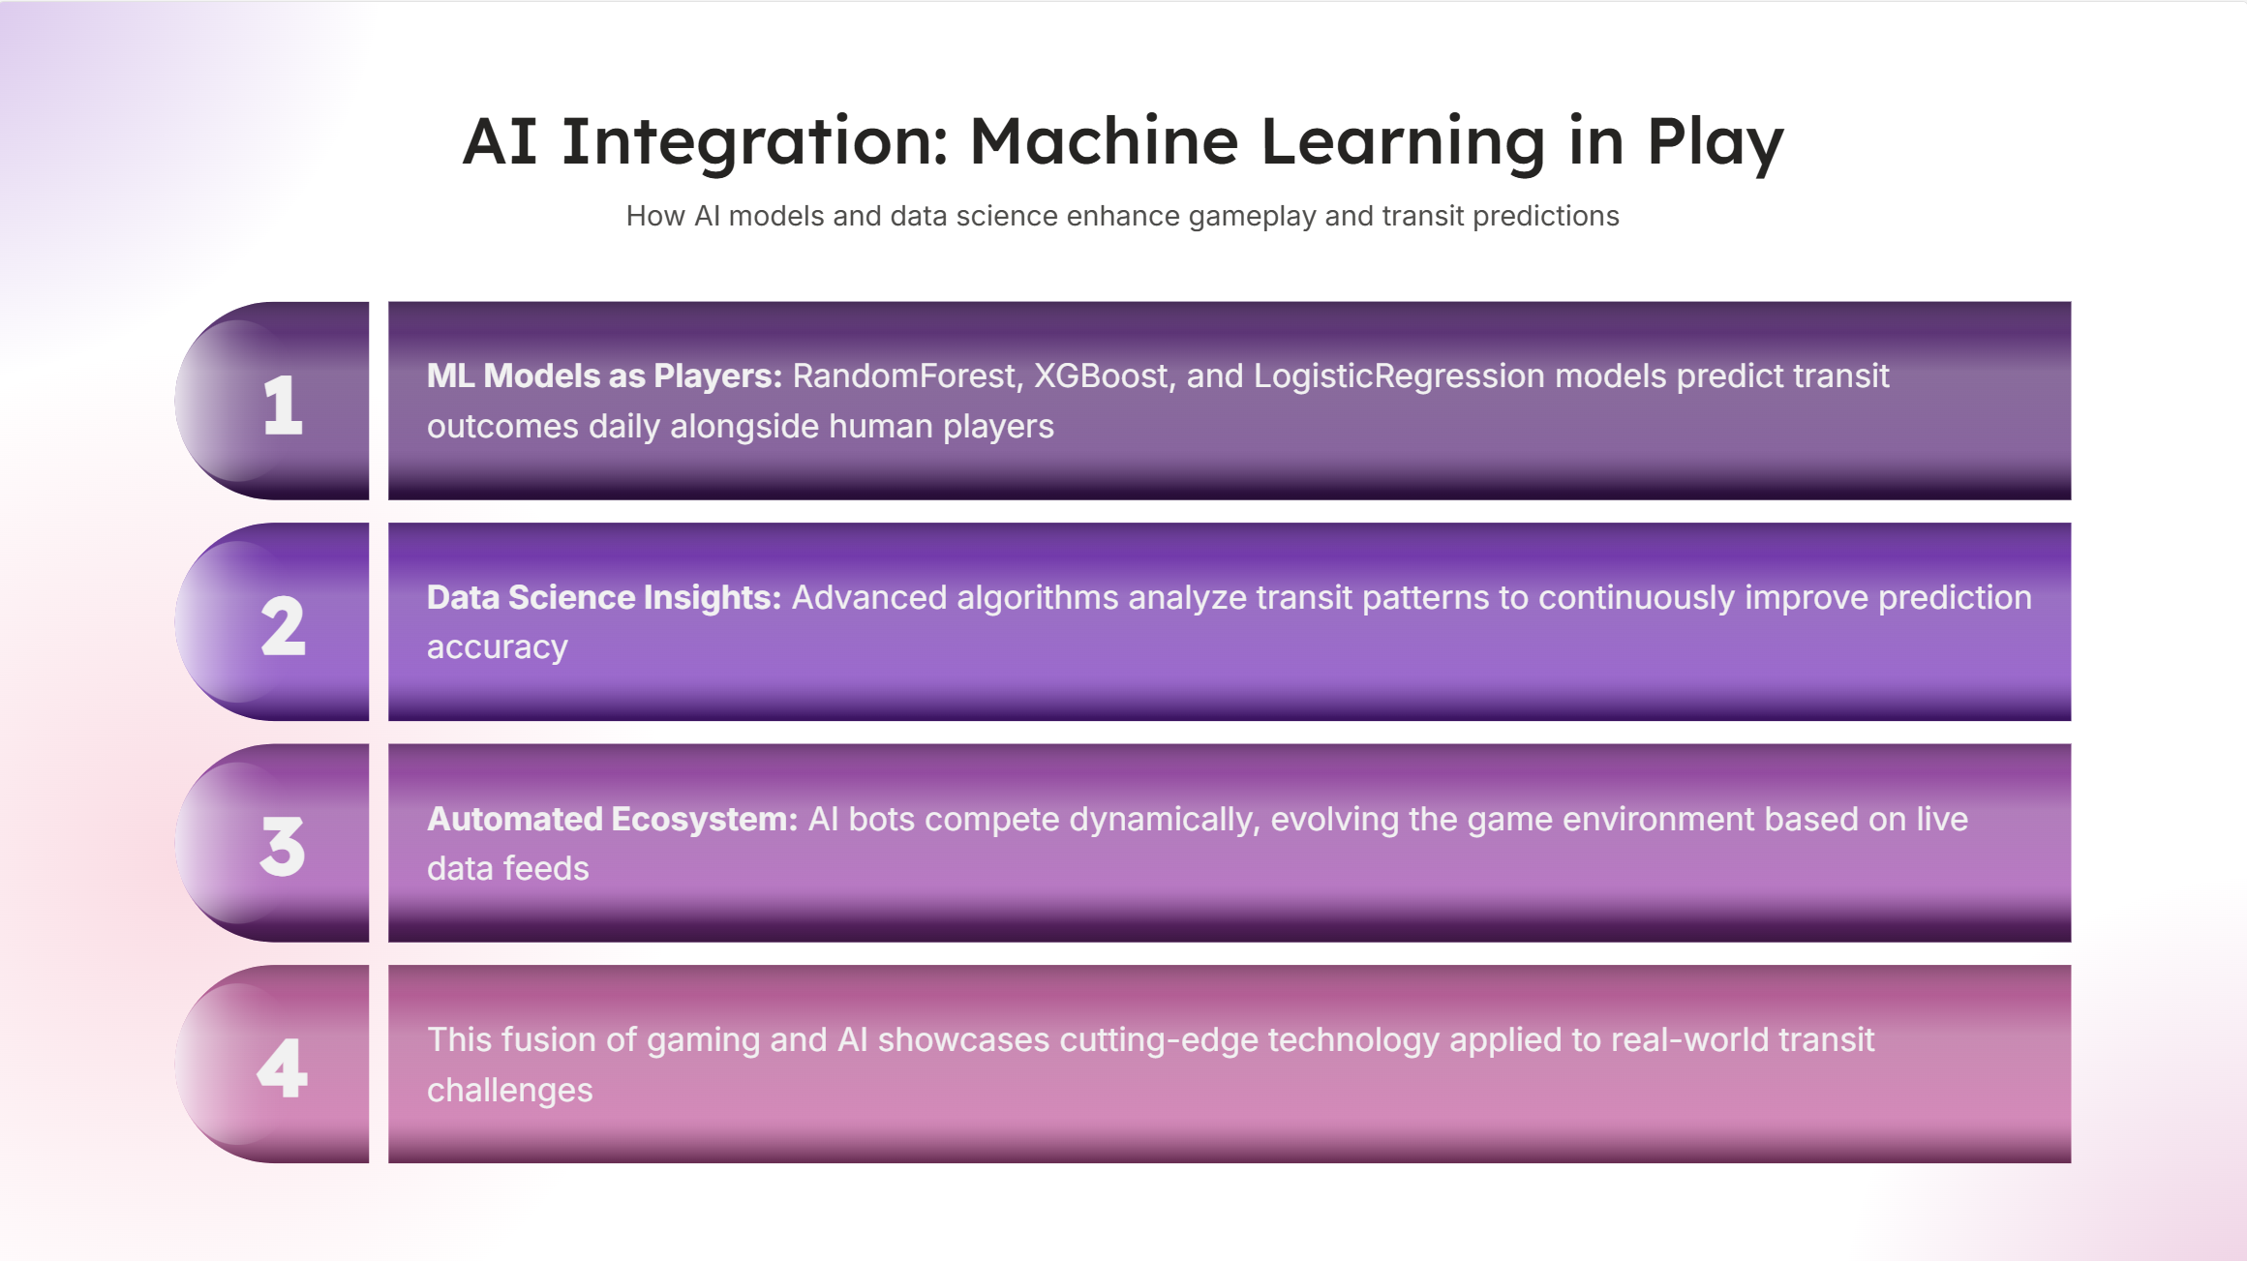
AI Integration
ML Models as Players: RandomForest, XGBoost, and LogisticRegression models compete alongside humans.
Advanced Data Science: Machine learning algorithms analyze transit patterns.
Automated Predictions: AI bots make daily predictions, creating a living ecosystem.

Slide 8
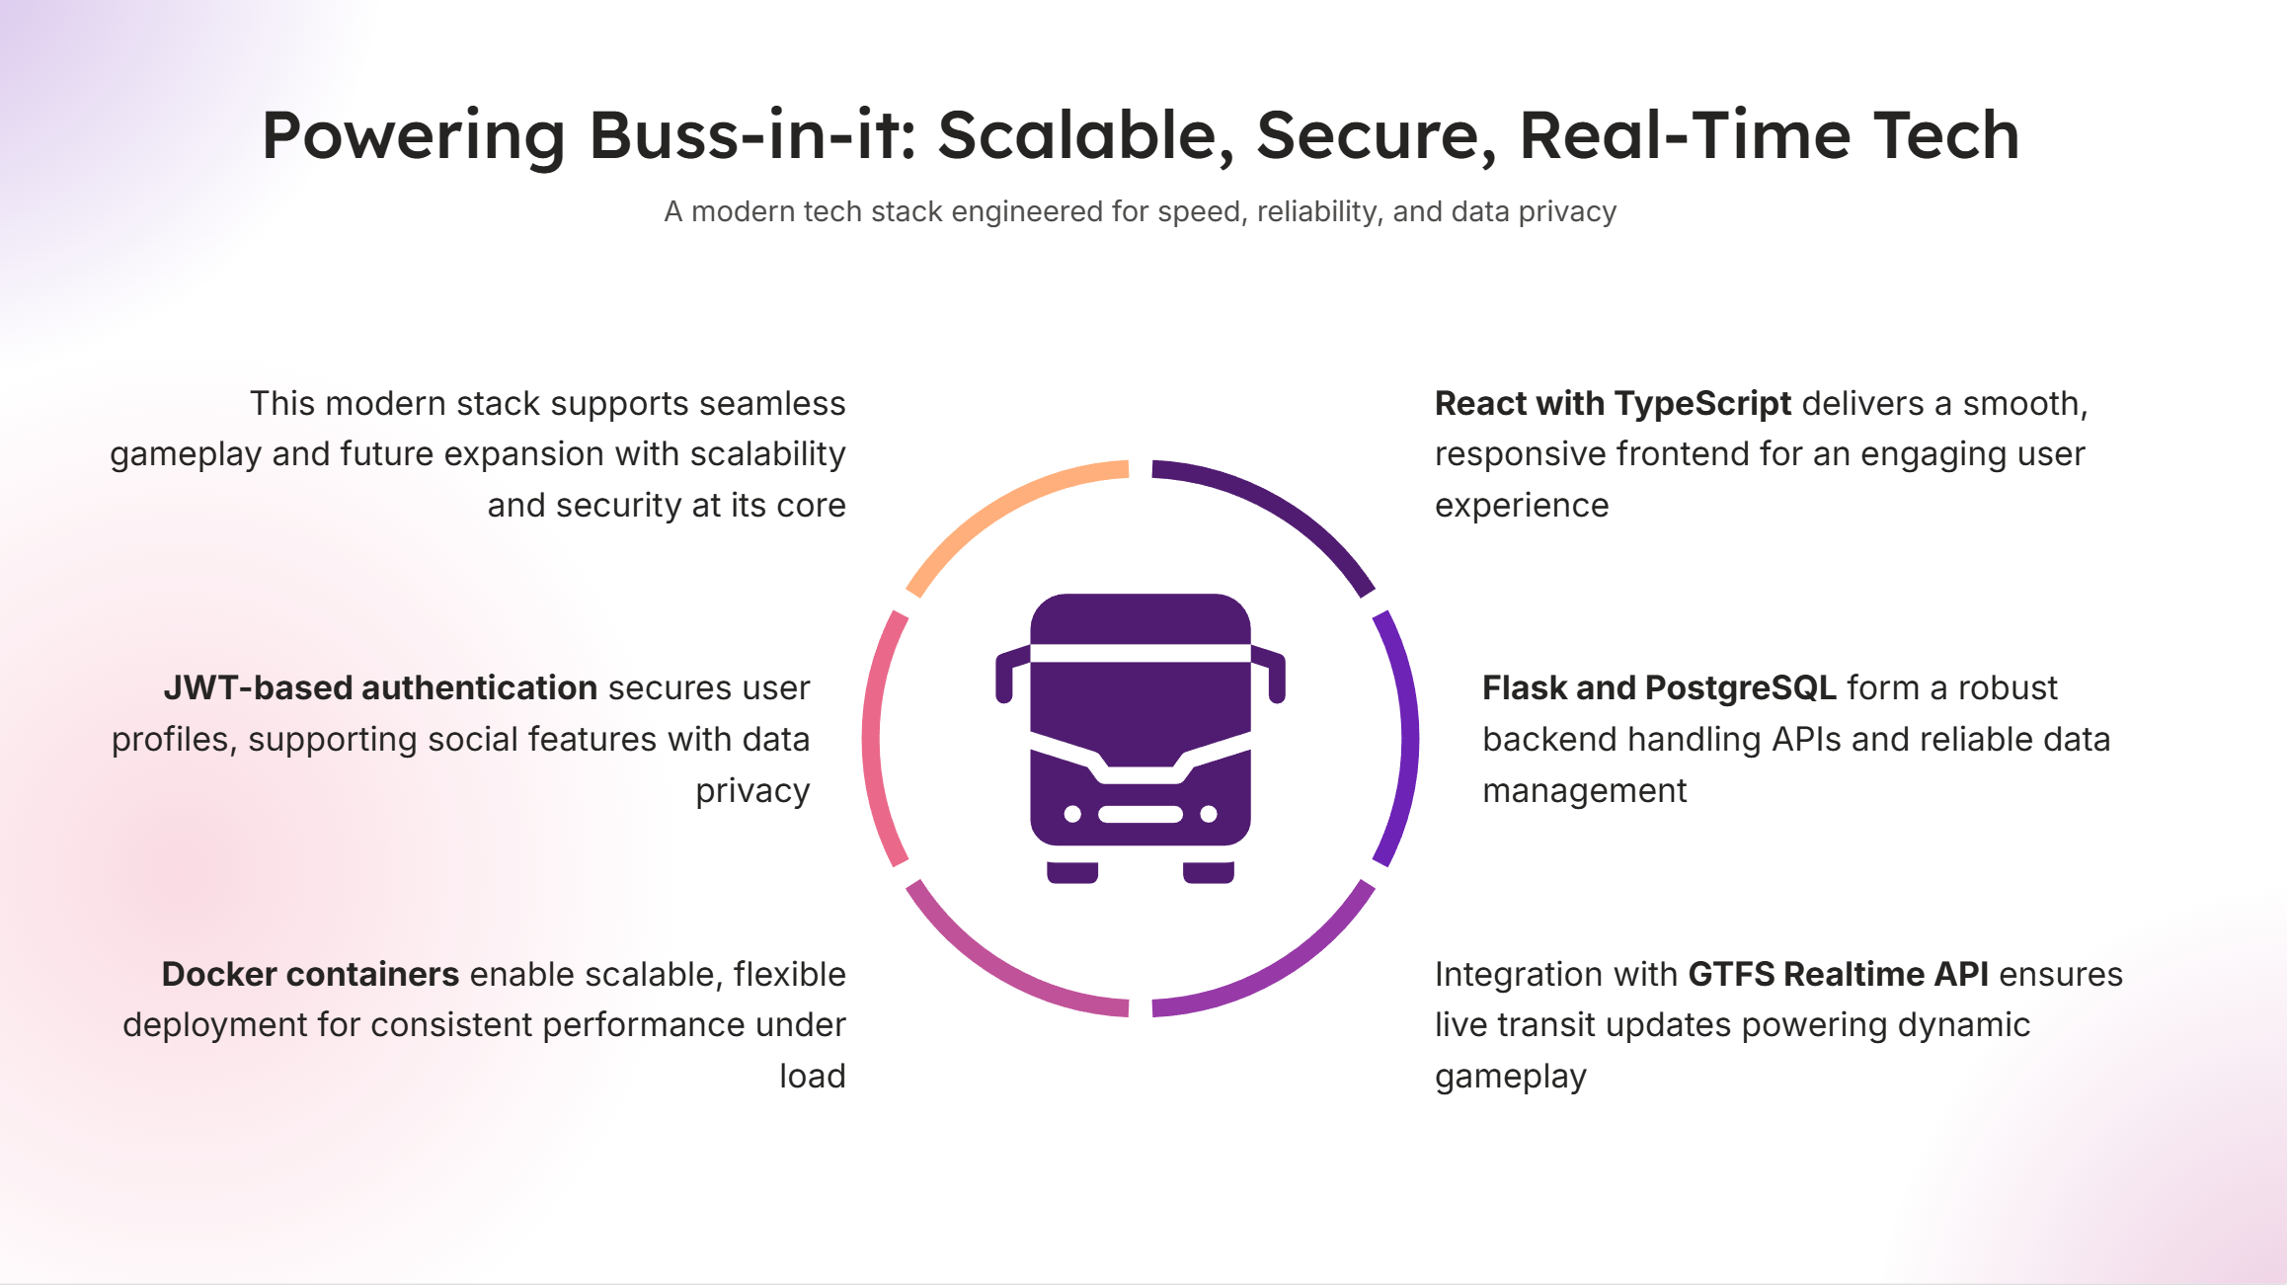
Our Tech Stack
Frontend: React + TypeScript for a smooth, responsive UI.
Backend: Flask + PostgreSQL for a robust API and data management.
Real-time Data: GTFS Realtime API integration.
Deployment: Docker for scalability and reliability.
Authentication: Secure JWT-based user profiles and social features.

Slide 9
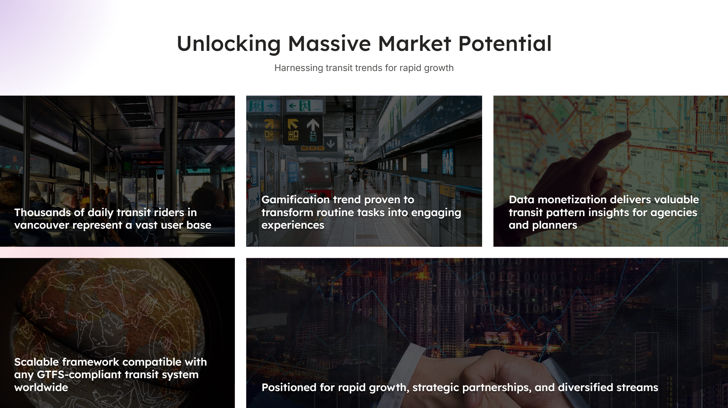
How to Play
1. Sign Up & Login: Quick registration with a nickname and email.
2. Browse Trips: View available bus trips for the day.
3. Make Predictions: Choose 'on time' or 'late' for upcoming trips.
4. Track Performance: Monitor your accuracy and score.
5. Compete Socially: Add friends and climb the leaderboard!

Slide 10
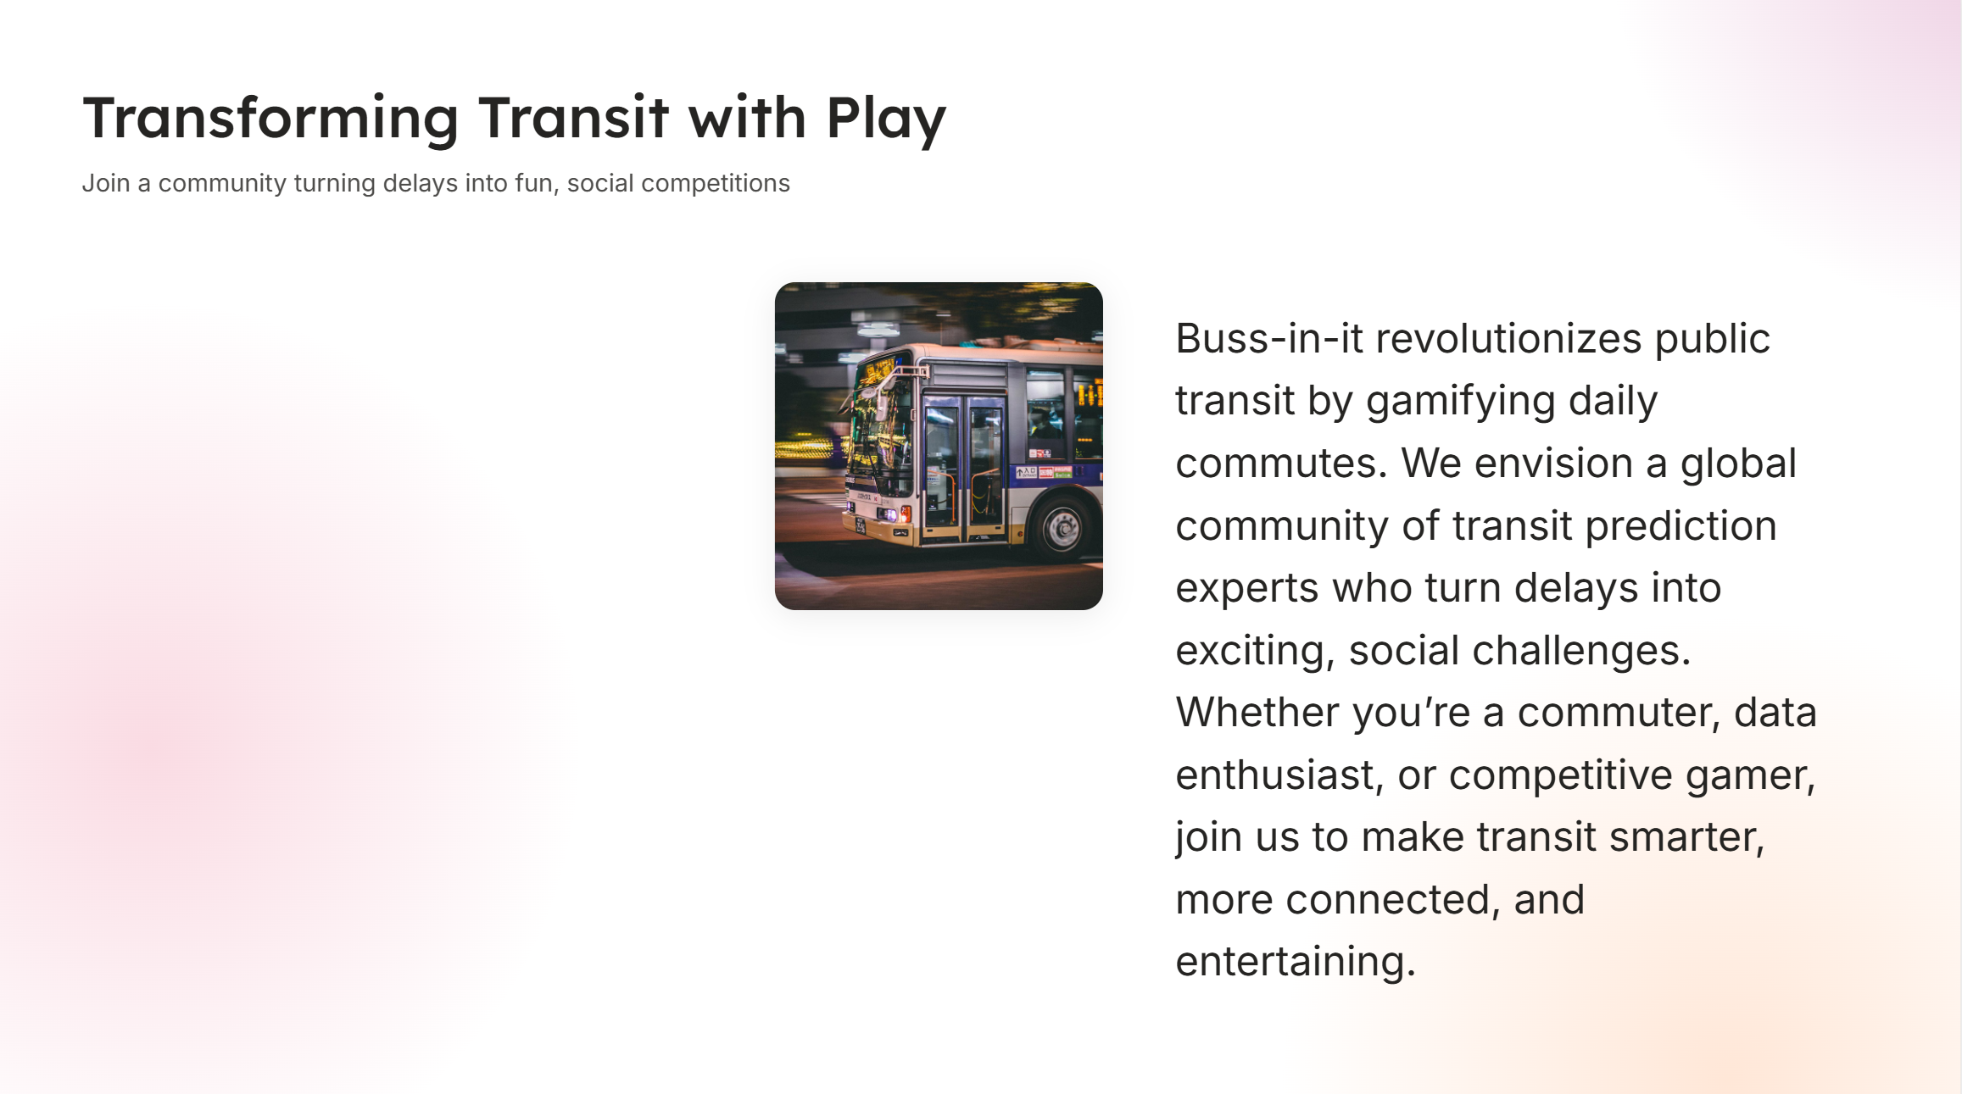
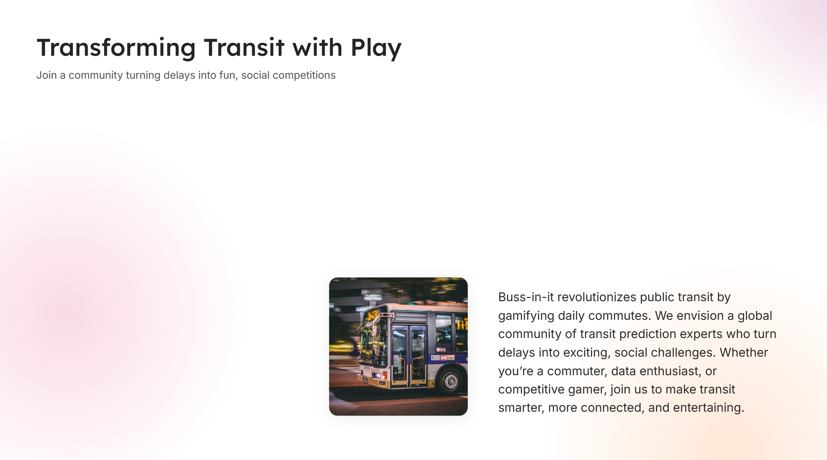

Market Opportunity
Massive User Base: Millions of daily transit riders worldwide.
Gamification Trend: Proven market for turning mundane tasks into games.
Data Monetization: Potential for insights into transit patterns and delays.
Expansion Ready: Framework supports any GTFS-compliant transit system.

